Slide 1





QUINTIN
SLIDE
TIME
000000
x0
1-1
0
GitHub Actions
ANDROID CI PIPELINE.
© 2020 ZUHLKE ENGINEERING, LTD

Slide 2


QUINTIN
SLIDE
TIME
000000
x0
1-2
120
Agenda
What are GitHub actions?
Unit test setup
Executing Espresso tests
Artefact generation
Still in the pipeline

Slide 3




QUINTIN
SLIDE
TIME
000000
x0
2-1
1920
What are GitHub actions?
custom SDLC workflows on repo
.yml / .yaml
strored in .github/workflows
events
actions
Documentation
Notes:
https://help.github.com/en/actions/reference/workflow-syntax-for-github-actions

Slide 4
QUINTIN
SLIDE
TIME
000000
x0
2-2
3720
steps:
- uses: actions/checkout@v1
- name: Run a one-line script
run: echo Hello, world!
- name: Run a multi-line script
run: |
echo Add other actions to build,
echo test, and deploy your project.
name: CI
on: [push]
jobs:
build:
runs-on: ubuntu-latest
Notes:
Just because it’s green does not necessarily mean it’s a reserved word! e.g. “Build” is just a name
ON:
on push, pull-request are options
you can specify branches and branches to ignore as sub-events in the “on” section
RUNS-ON:
ubuntu-latest, macOS-latest, windows-latest
-latest - you can also specify a version
Remember the platform you use, because that will determine which shell script you can use
ACTIONS
Some actions are built-in, like checkout
Others are developed independently
You can also use docker actions

Slide 5
QUINTIN
SLIDE
TIME
000100
x0
3-1
9120
Unit Test Setup
jobs:
unittest:
name: Run Unit Tests
runs-on: ubuntu-latest
steps:
- uses: actions/checkout@v1
- name: Set Up JDK 1.8
uses: actions/setup-java@v1
with:
java-version: 1.8
- name: Execute Unit Tests (gradlew)
run: bash ./gradlew test --stacktrace
name: Android Master
on:
pull_request:
branches:
- master
push:
branches:
- master
Notes:
https://help.github.com/en/actions/reference/workflow-syntax-for-github-actions

Slide 6
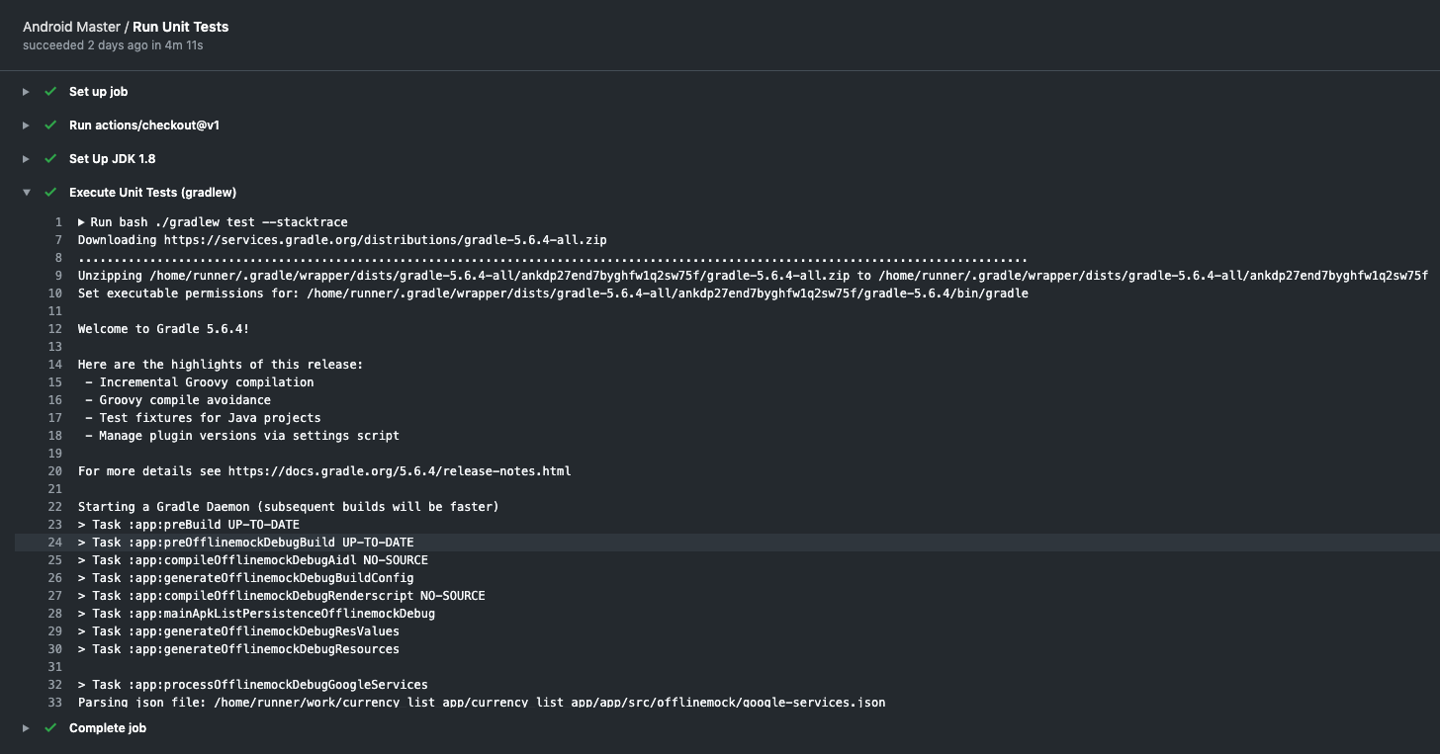

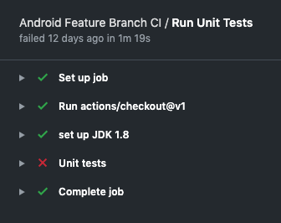
QUINTIN
SLIDE
TIME
000200
x0
3-2
9420

Slide 7

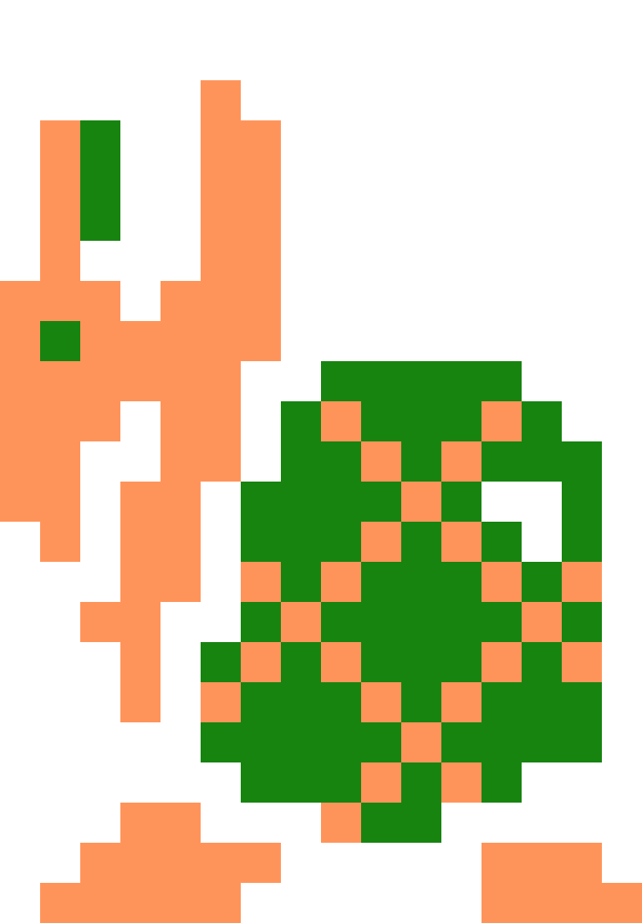
QUINTIN
SLIDE
TIME
001200
x0
4-1
12300
Espresso Test Setup
- name: Execute Instrumentation Tests
uses: reactivecircus/android-emulator-runner@v2
with:
api-level: 23
target: default
arch: x86
profile: Nexus 6
script: ./gradlew connectedCheck --stacktrace
Notes:
Gotcha’s:
api-level is important. Make sure you use the same one as your local machine
remember your test pyramid - espresso tests are not substitutions for bad architecture

Slide 8




QUINTIN
SLIDE
TIME
031200
x0
5-1
12420
Artifact Generation
- name: Build APK
run: bash ./gradlew assembleBFDebug --stacktrace
- name: Upload Artifact
uses: actions/upload-artifact@v1
with:
name: app-BF-${{ github.run_number }}-debug
path: app/build/outputs/apk/BF/debug/app-BF-debug.apk
Notes:
${{ github.run_number }} is the build number
BF = Build Flavour

Slide 9
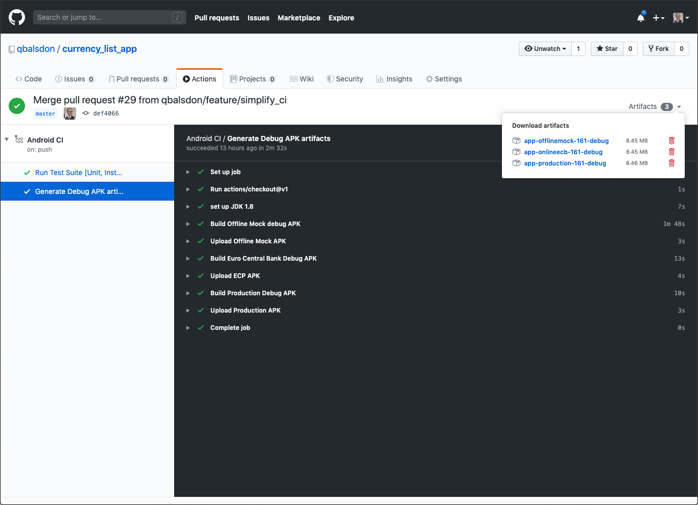
QUINTIN
SLIDE
TIME
062400
x0
5-2
12540

Slide 10
QUINTIN
SLIDE
TIME
062400
x0
6-1
?????
Still in the pipeline
upload test results as an artefact
generation of production (rc) artifacts
automatic deployment to the play store?
Notes:
Do not allow third parties to use the APIs to publish to your account on your behalf. Do not use the APIs to offer a developer service or tool which creates, uploads, publishes, distributes or updates apps to the Google Play Store. Doing this is a violation of the Google Play Developer API Terms of Service. Such actions may result in your account being suspended, and your apps removed from the Google Play Store. Everything done on your account is your responsibility, and allowing a third party to use your account puts all of your users at risk.

Slide 11

QUINTIN
SLIDE
TIME
999999
x0
5-2
12540
THANK YOU,
BUT THERE’S MORE
CI IN ANOTHER CASTLE!
My repo:
https://github.com/qbalsdon/currency_list_app

